Slide 1

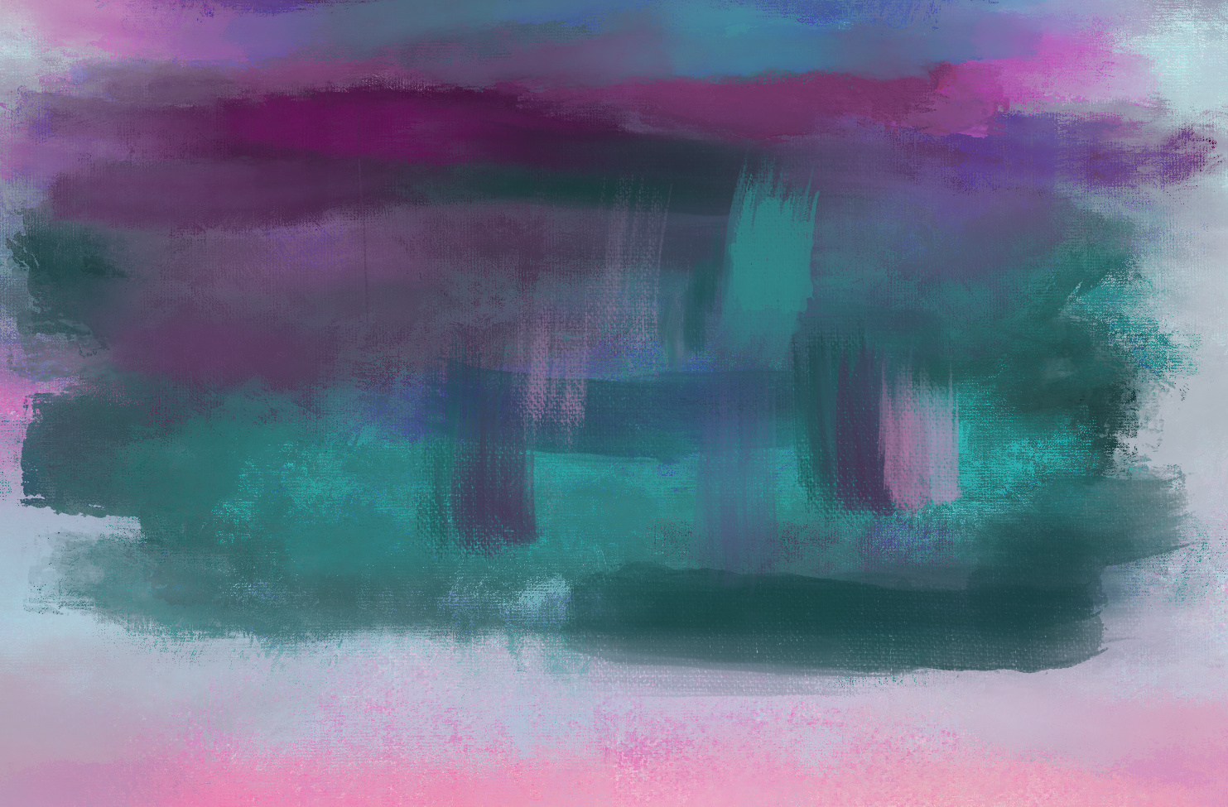
Flor Ariana Fabela
Mid-term Portfolio
Painting I
Spring 2021

Slide 2
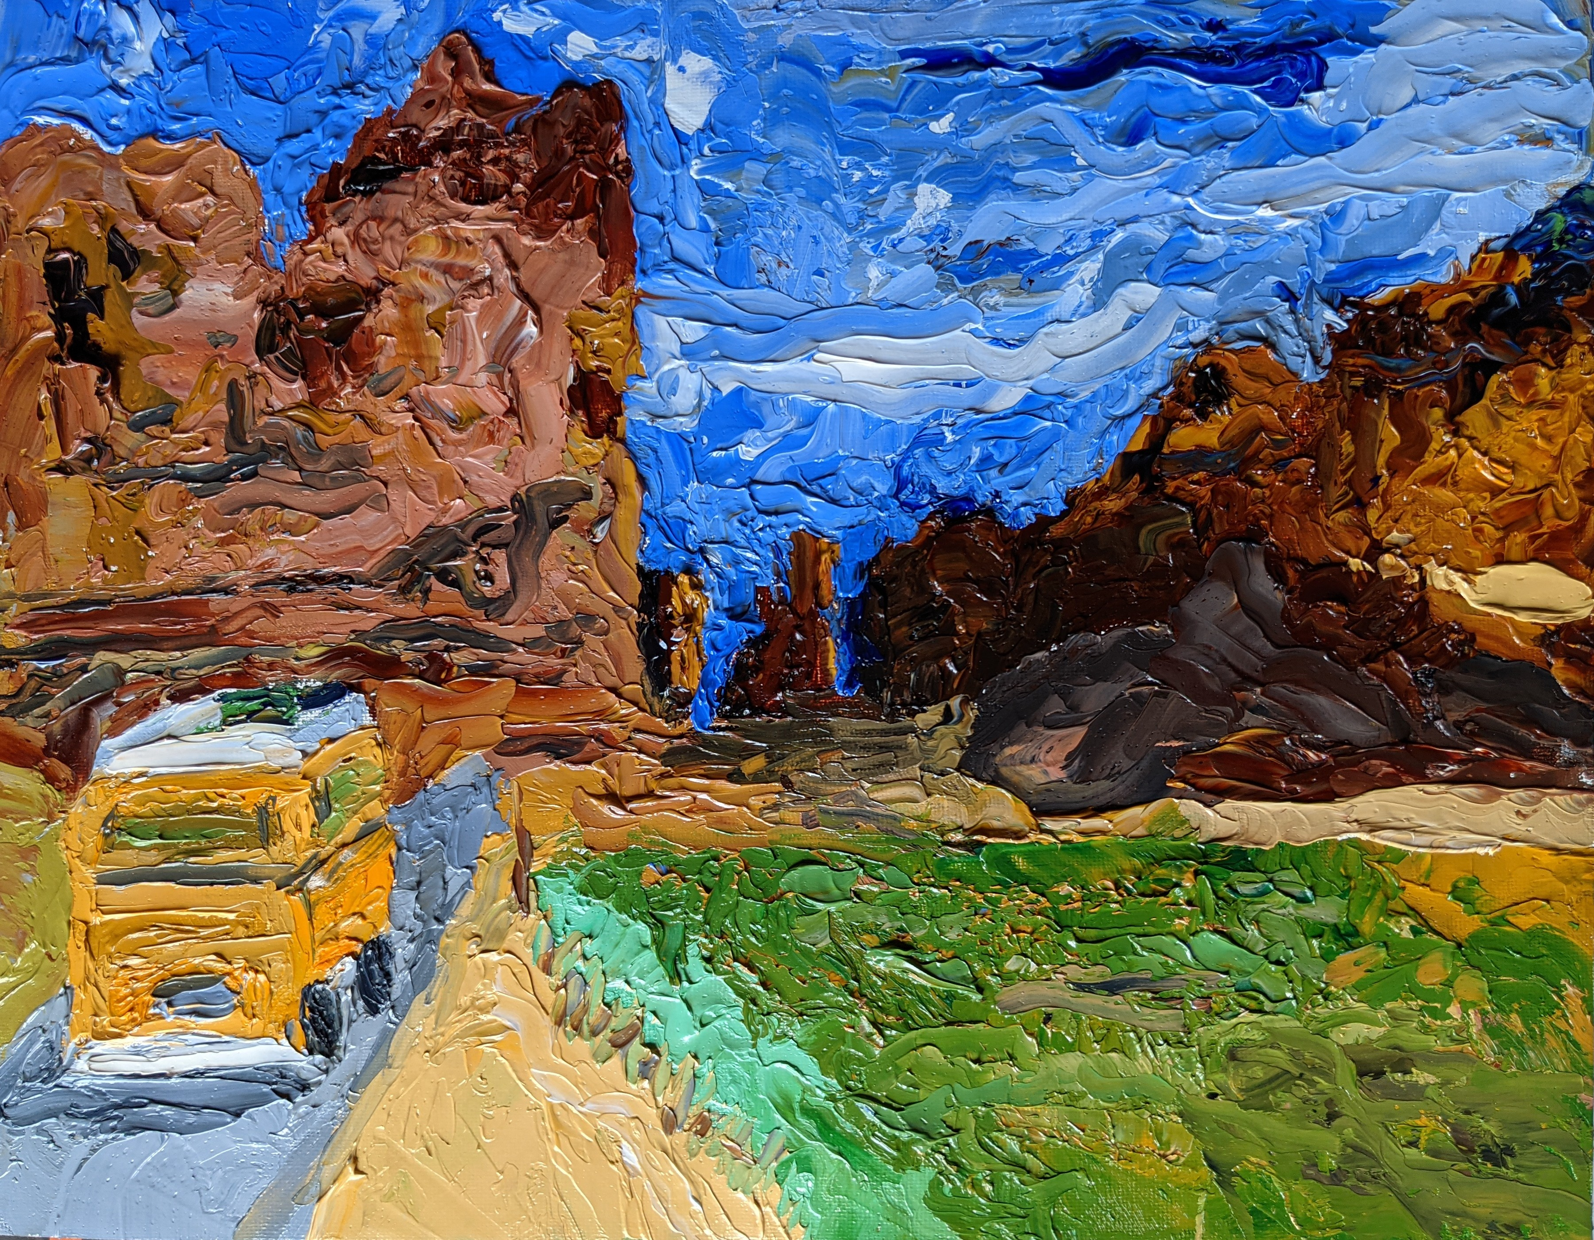
Impasto I

Slide 3
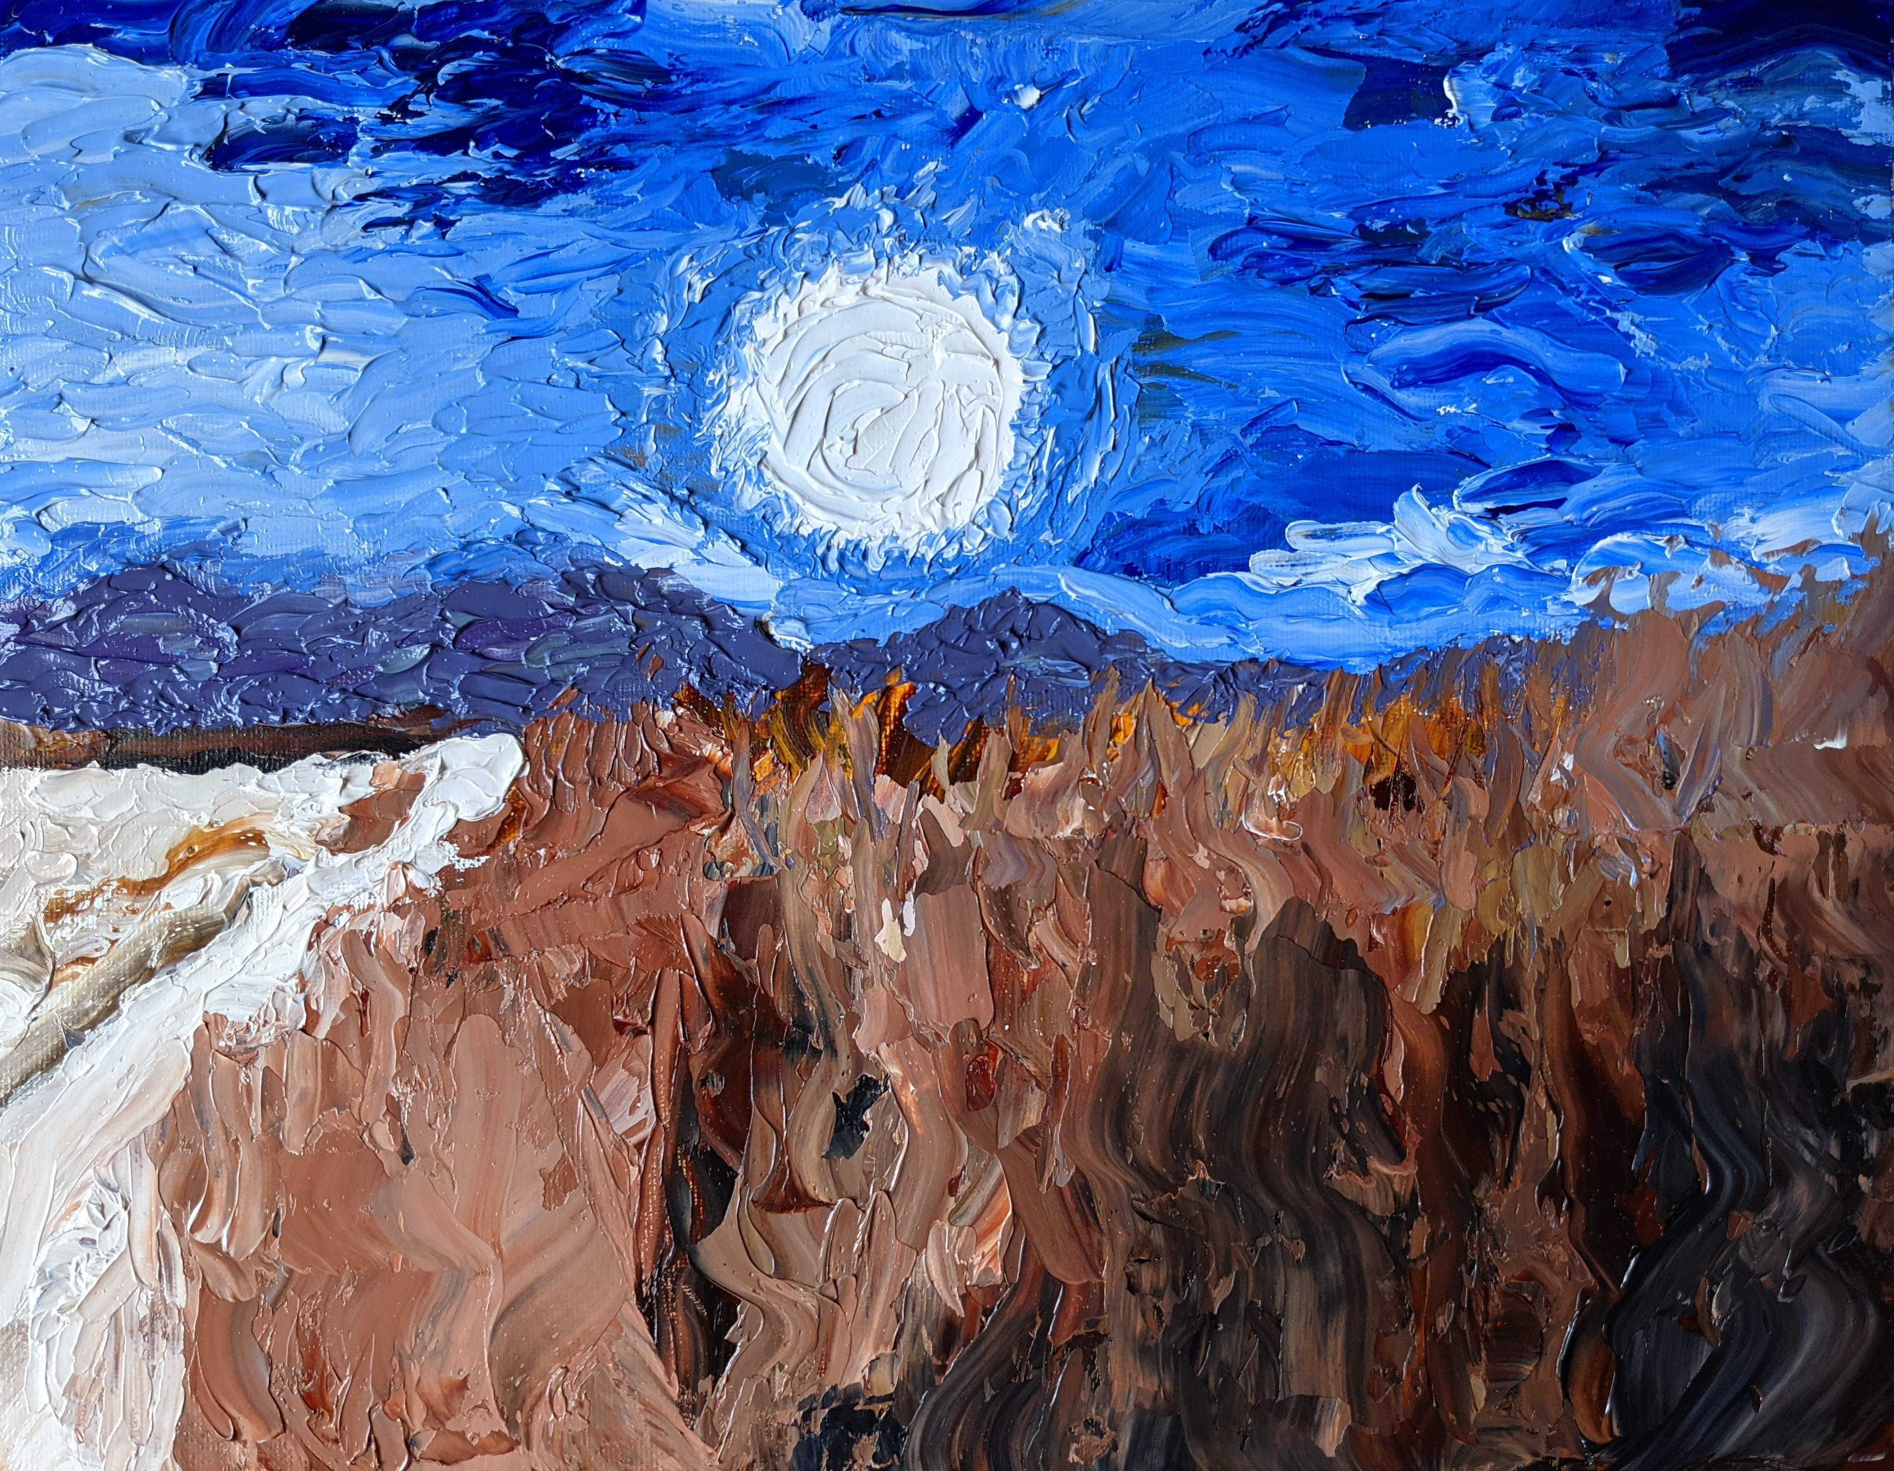
Impasto II

Slide 4
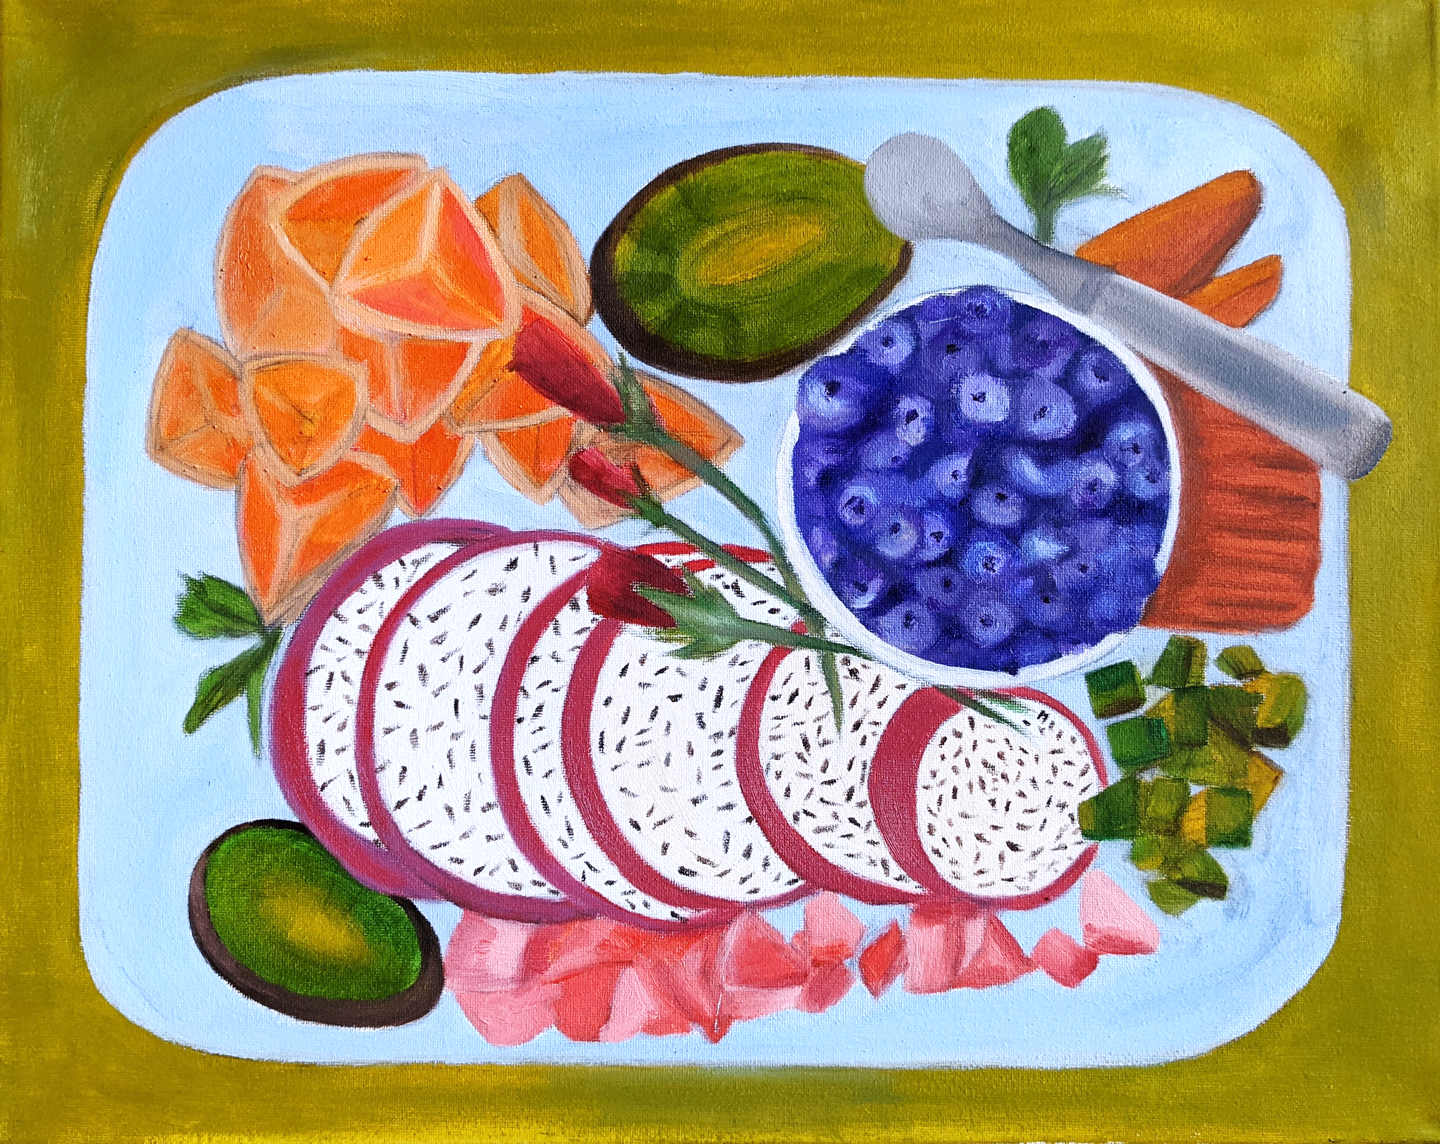
Food Study

