Slide 1

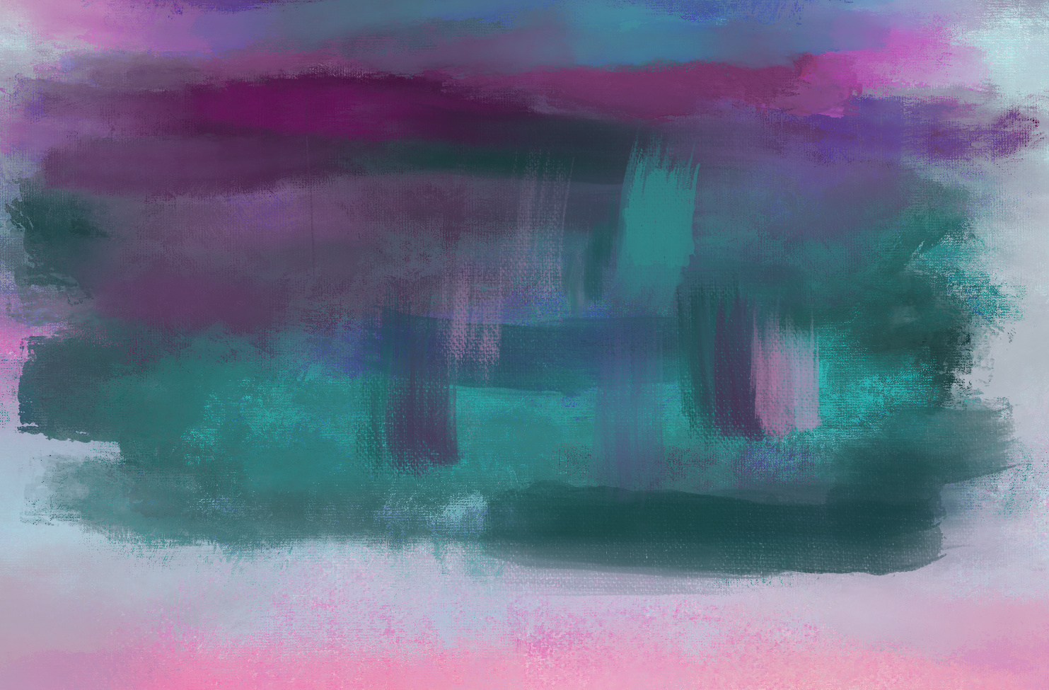
Flor Ariana Fabela
Mid-term Portfolio
Painting I
Spring 2021

Slide 2
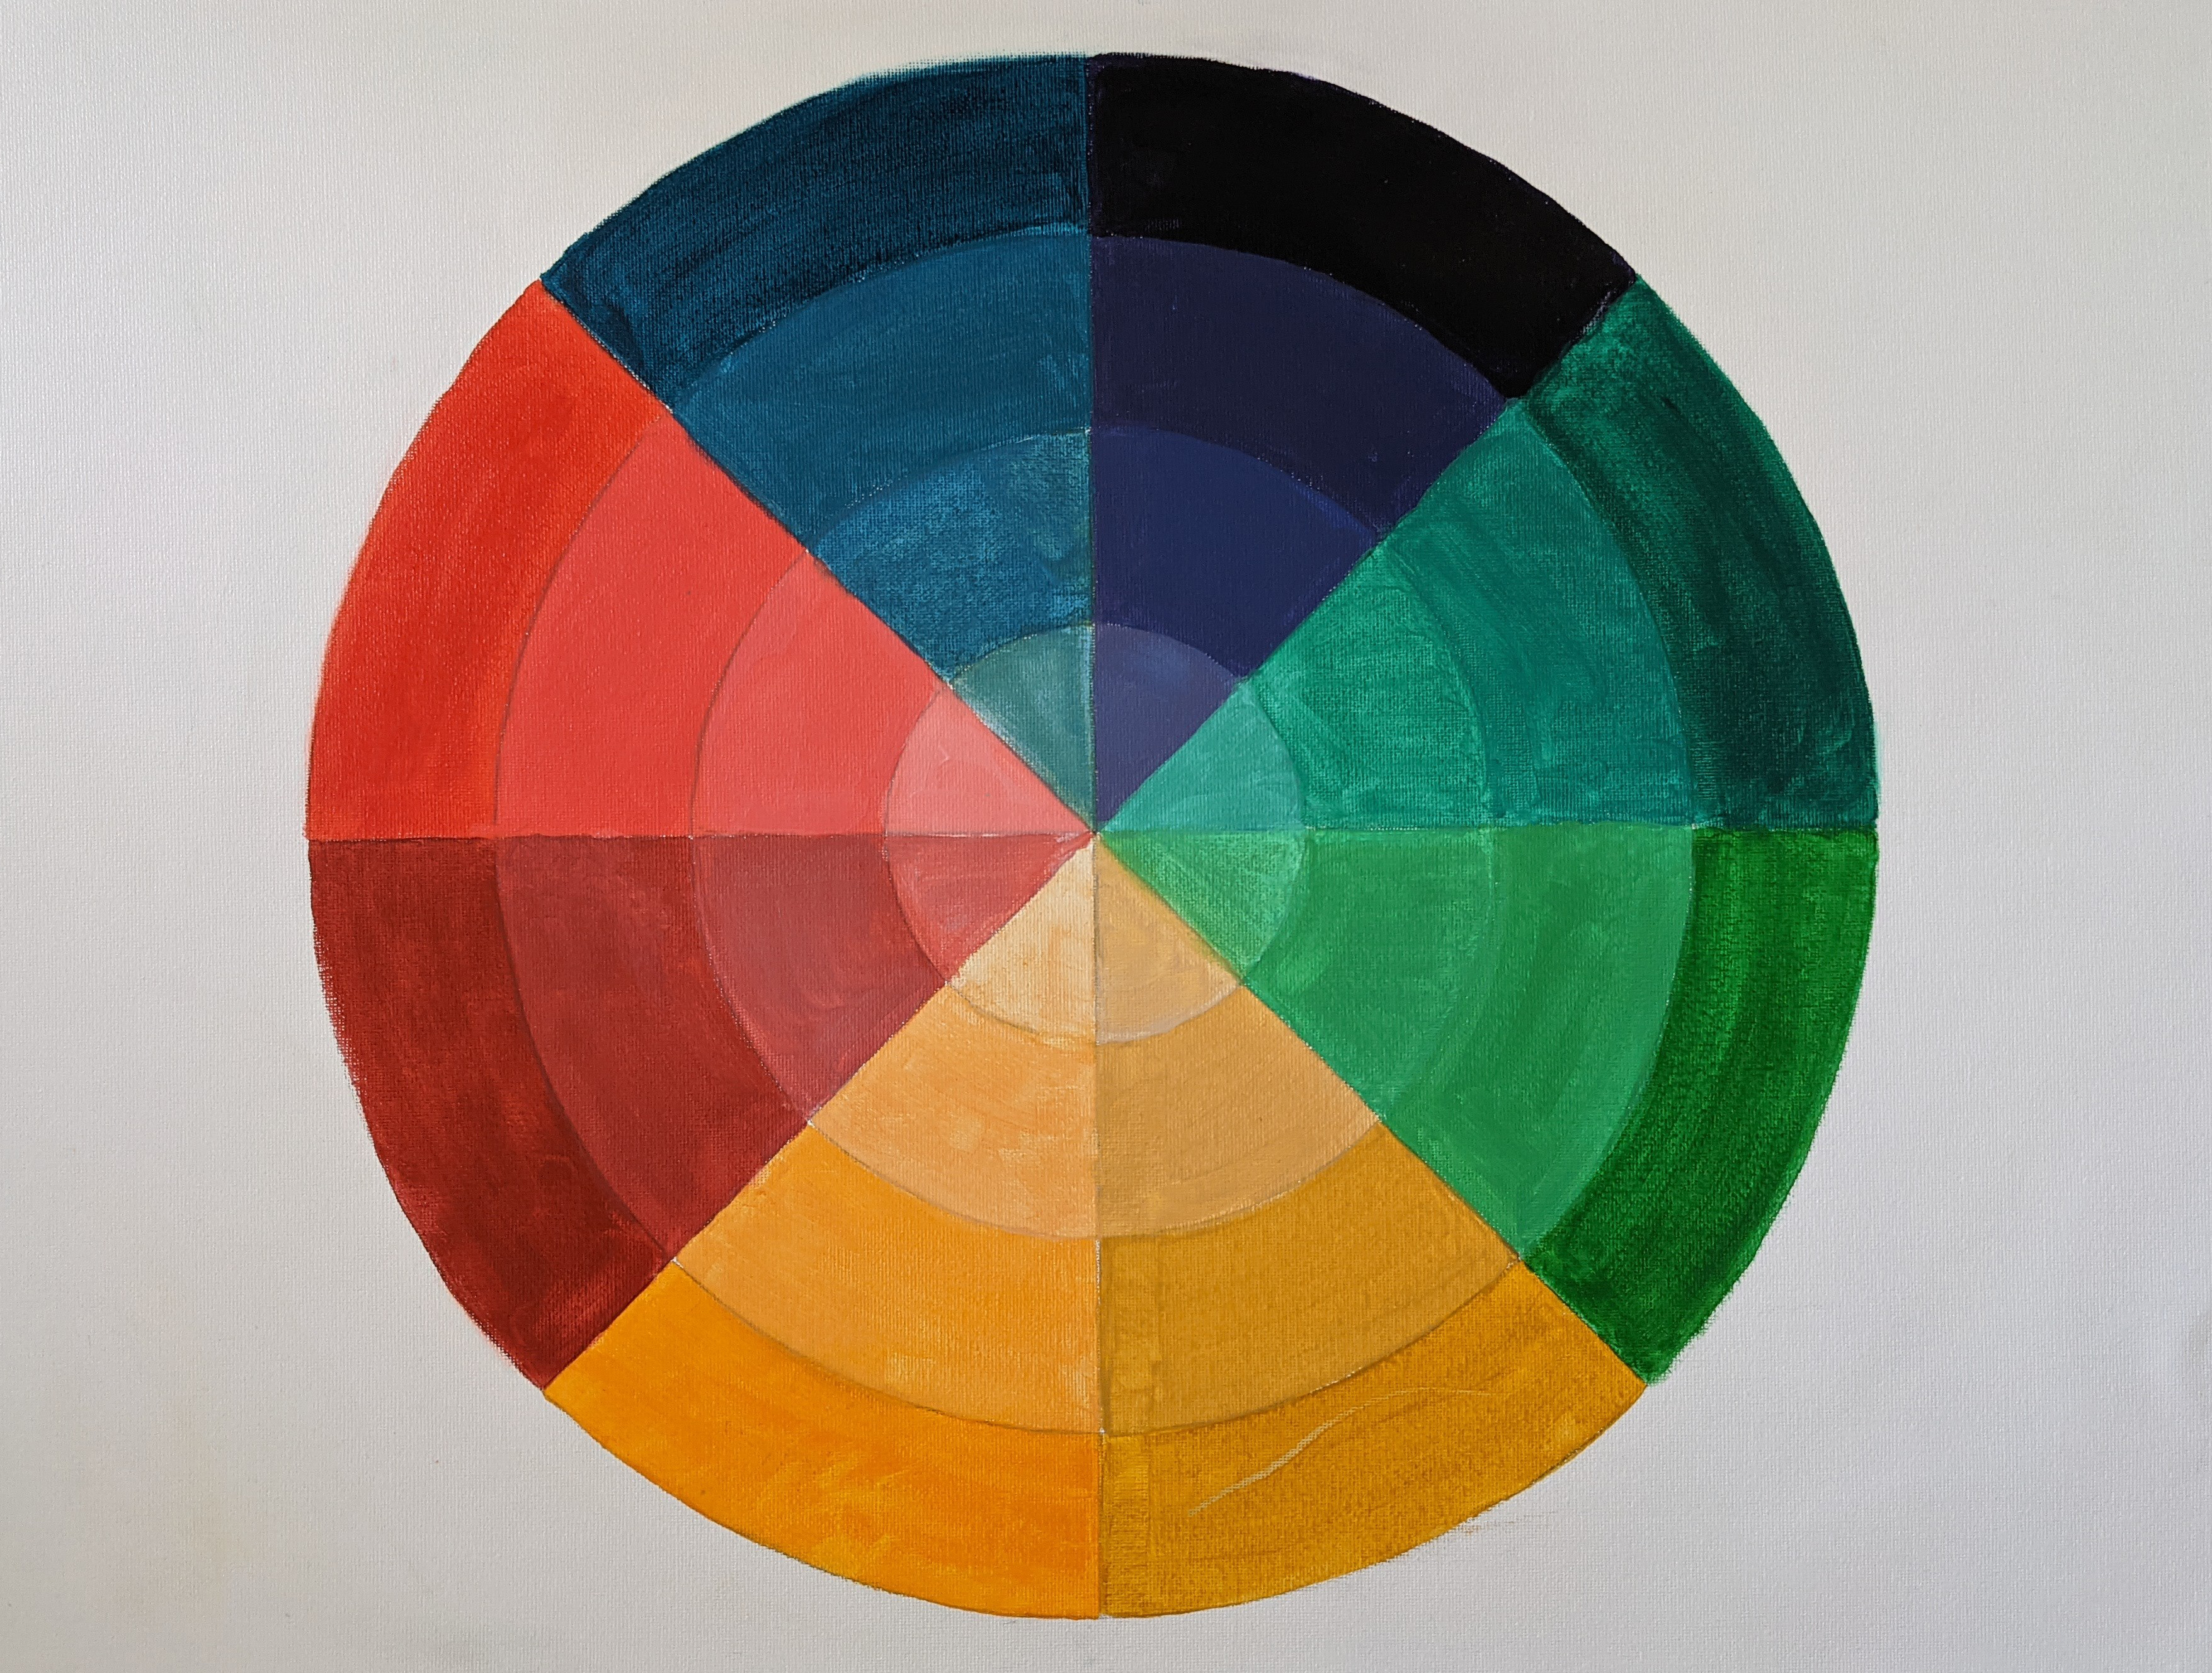
Color Wheel

Slide 3
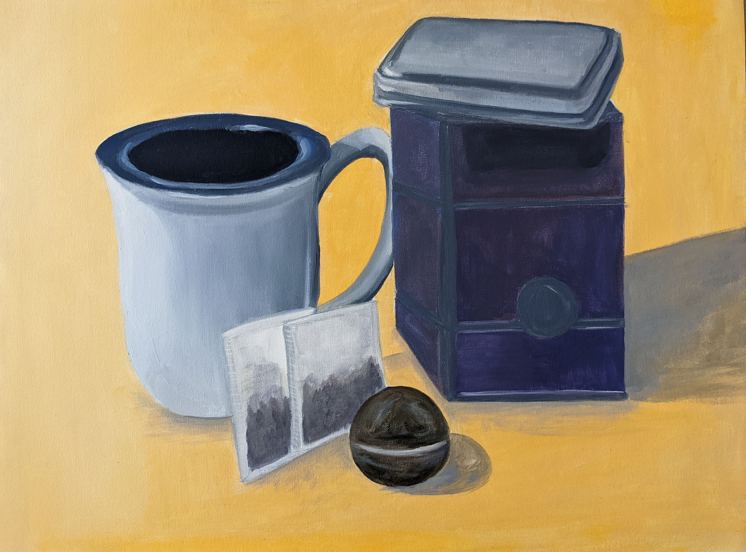
Value Study

Slide 4
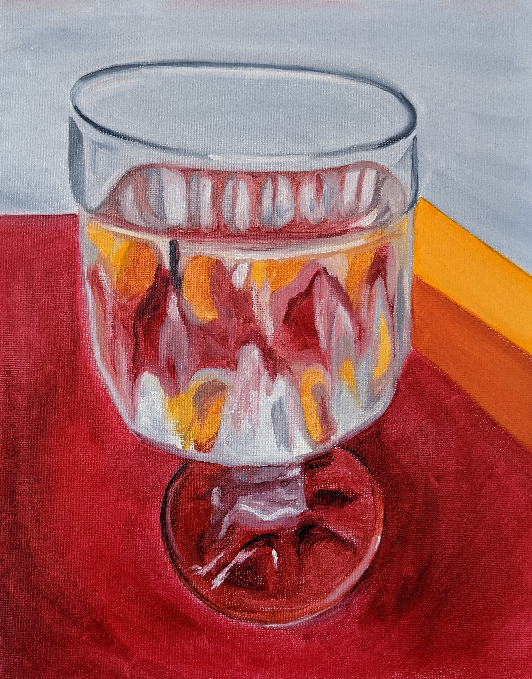
Analogous Color Study

Slide 5
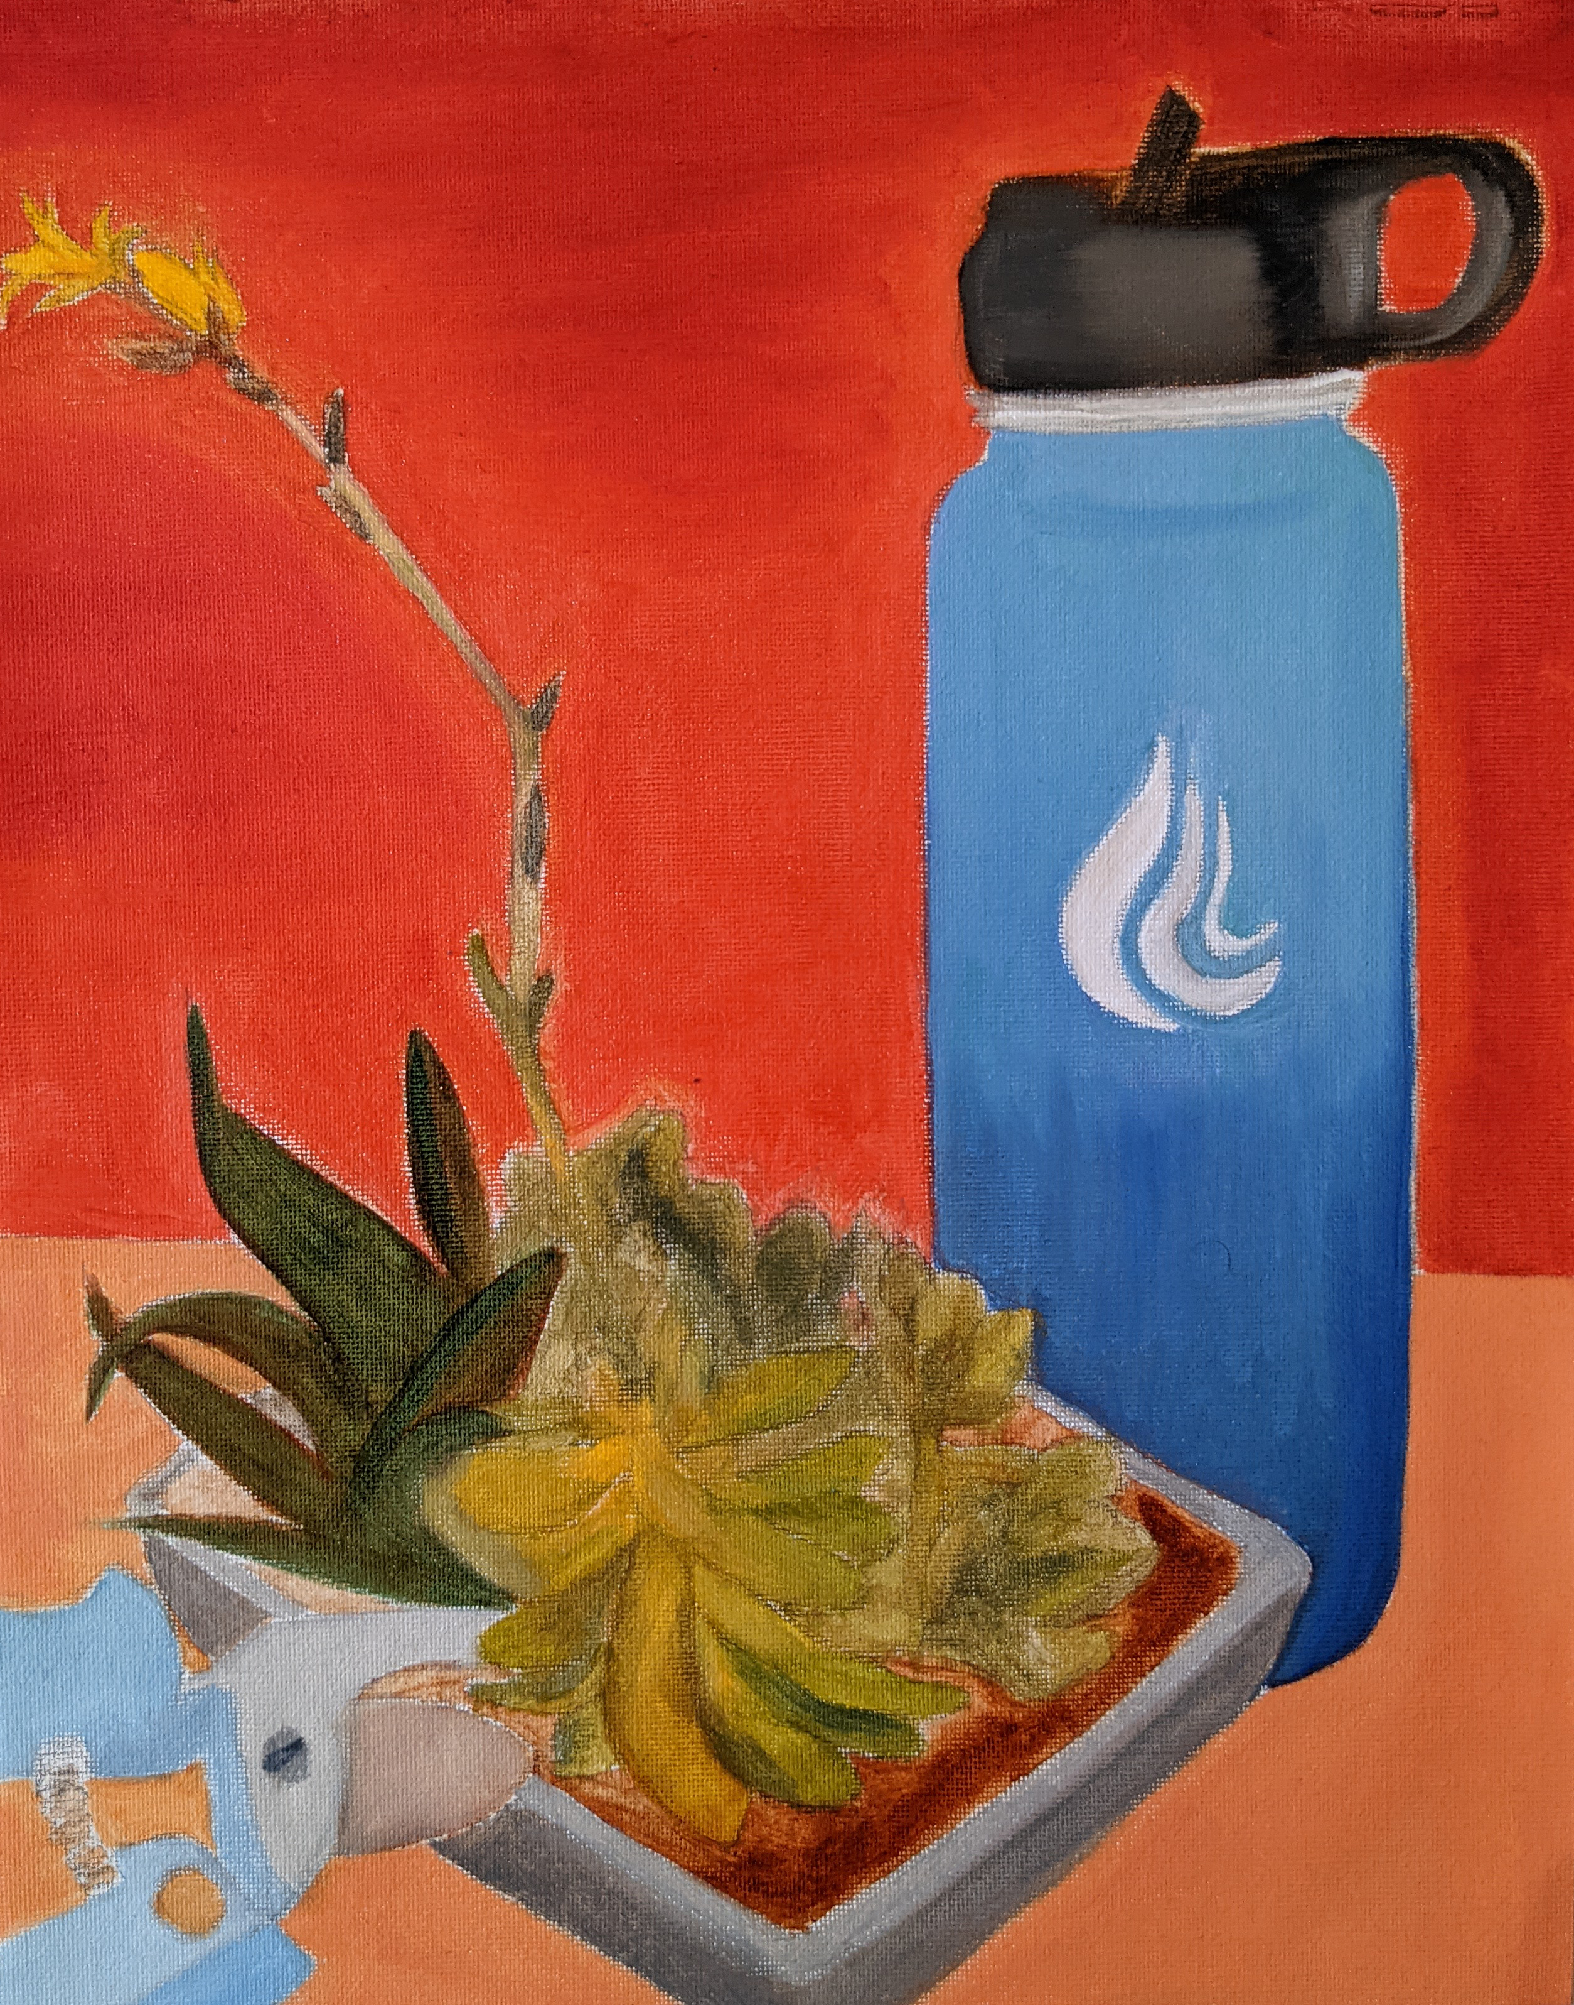
Complementary Color

Slide 6
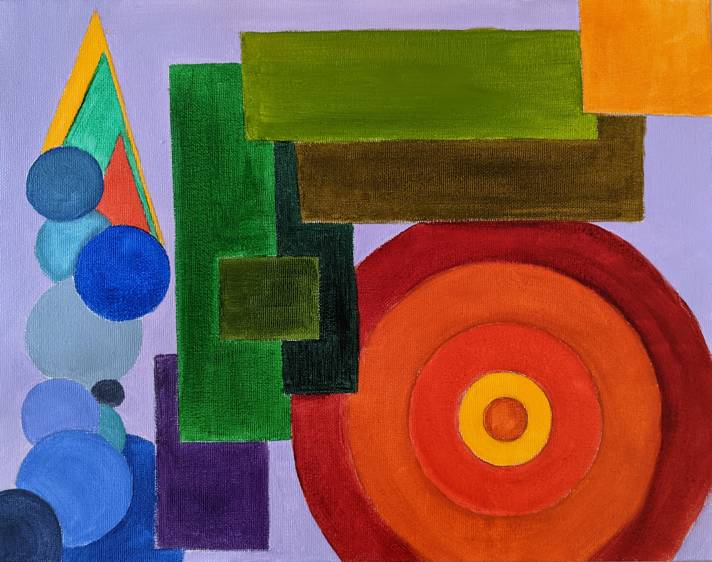
Abstract Color Space

Slide 7
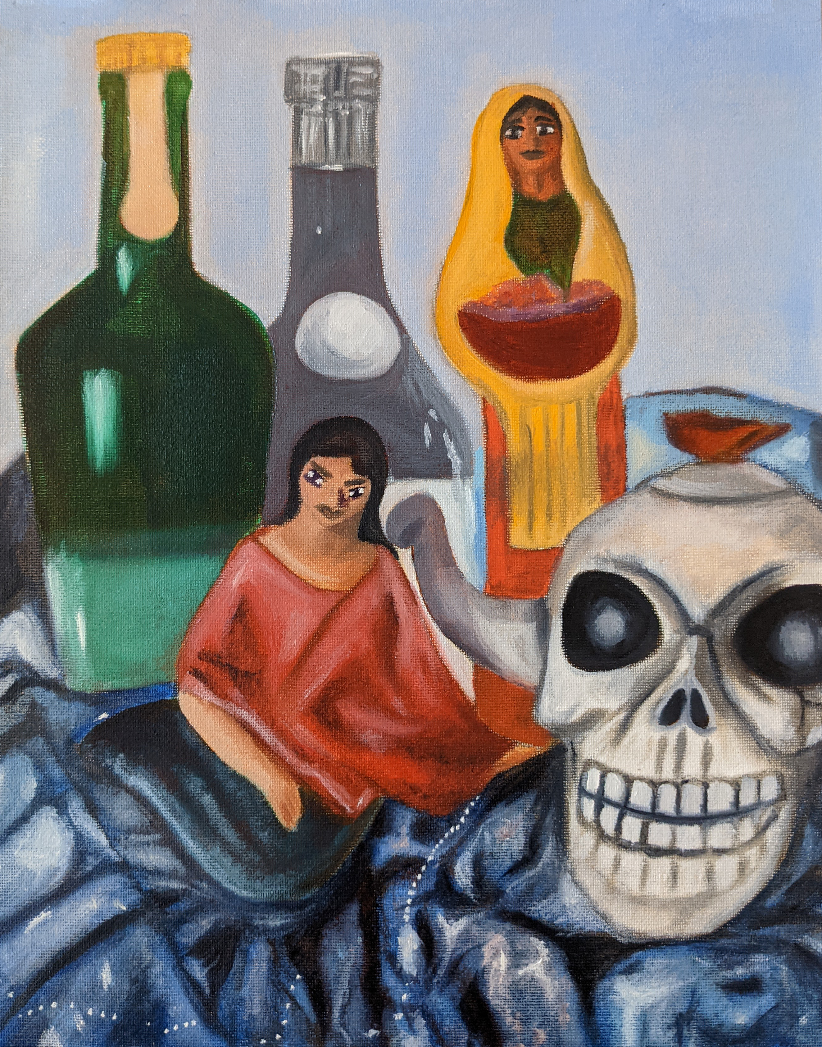
Glazing Project

